Slide 1
VBA for Excel
Ecole de Management Leonard de Vinci
Session 4
Achraf Seddik
seddik.achraf.1@gmail.com

Slide 2
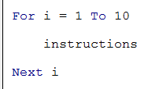
Loops (For, Do)
In programming it is often necessary to repeat the execution of tasks. To do so we use repetitive structures often called "Loops".
Lesson Objectives :
Mastering repetitive Structures like the “For” Loop, “Do While” loop or “Do Until” loop.
For loop : Syntax example :
This loop allows to repeat the instructions between the For (start of the loop) and the Next (end of loop).
“i” is the loop variable; we define its start value (here equal to 1) and its end value (here equal to 10). With each passage on the instruction
“Next i”, the variable i is incremented by one unit and the program goes back to the beginning of the loop. So here will “pass” ten times in this loop.

Slide 3
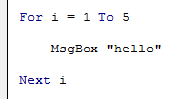

For loops
Example 1 :
Example 2 :
This loop displays in a message box “hello” 5 times
This loop displays 3 then 2 then 1. “step -1” means that the loop is decremented by a unit

Slide 4
Do… Loops (loop with condition)
Do … Loop While
Do … Loop Until :
Repeat the instructions while the condition is verified
Repeat the instructions until the condition is verified

Slide 5
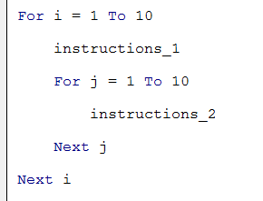
Imbricated for loops
Example :
Repeat “instructions_1” i times
“Instructions_2” are run j times for the first value of i
“instructions_2” are then repeated i x j times

Slide 6
Lesson 4 Arrays

Slide 7
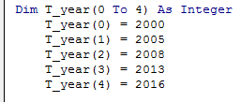
Arrays (Tables)
Arrays allow to manage easily a data set (generally of the same type)
Lesson Objectives :
Create an Array, assign values to it, display its content.
Know how to carry out basic operations on a data table.
Note : loops will be used to carry these operations
Syntax example :
We declare an Array by giving it :
A name (here “T_year”),
The range of the array (here 0 to 4)
The type of data it will contain (here integer)
Note : Indexes starts at zero by default : T_year(4) = T_year(0 to 4)
Note : We can force indexes to start at another value (for i = 1 to 5)
Note : We can access arrays using for loops (here for i = 0 to 4)

Slide 8
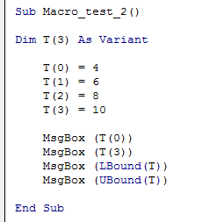
Arrays (Tables)
Useful functions on Arrays :
Erase (T_year) : to delete an array
Lbound (T_year) : returns 0
Ubound (T_year) : returns 4
Example :
What does this macro display ?

Slide 9
Applications Exercice Sheet N°2

Slide 10
Appendix.
1. VBA variables types
2. Operators
Arithmetic | ^ | - [negation] | * | / | + | & | Mod
Comparaison | = | <> [different] | < | > | <= | >= | Like | Is
Logical | Not | And | Or | Xor | Eqv | Imp

